Slide 1
High-Intensity Scripting
Revisiting Speed Optimizations with PowerShell 7
Or: PowerShell 7 Go BRRRR
Josh King

Slide 2


Who am i?
Josh King
ToastIT.dev
@WindosNZ
Microsoft MVP
TechOps Sysadmin @ Tribe

Slide 3
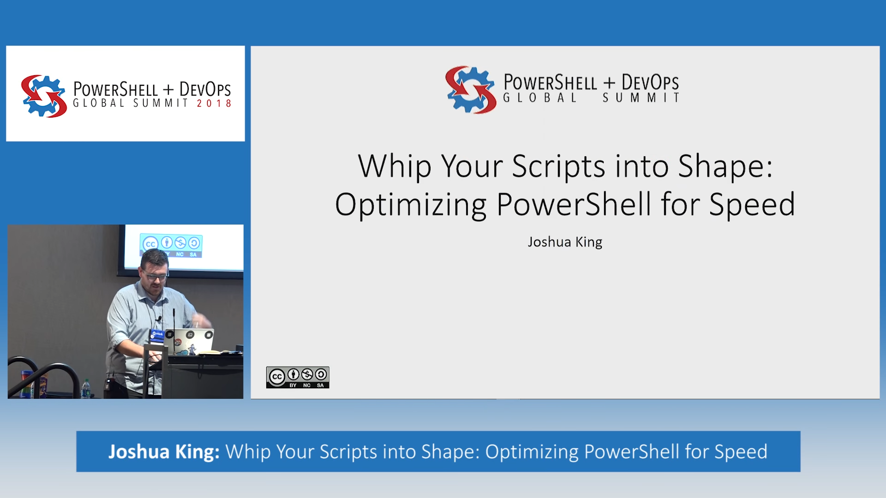
Revisit?
What’s changed?
PowerShell 7 = Magic?
https://toast.click/PS7-GA
https://toast.click/WhipYourScripts

Slide 4
Fundamentals (which won’t be re-tested)
Displaying output is slow
Filter left
Parallelization is (usually) a winner

Slide 5
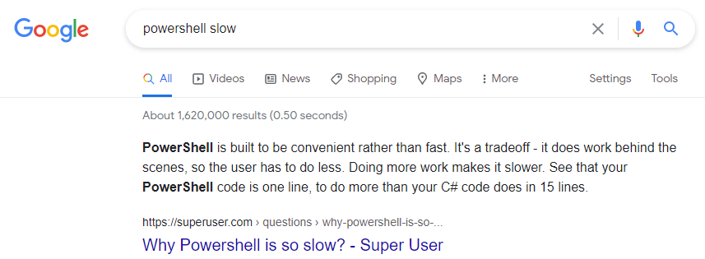
Why worry About Speed in PowerShell?

Slide 6
Testing Methodology
If you’re looking for improvements, measure it!
Make one change at a time
Test it more than once
Don’t slow things down by measuring it…

Slide 7
Code time!
(Enough with the words)

Slide 8
So, I just take these results and run with them?
NO WAY!
You’ve got to think about memory and processor constraints
Don’t go breaking scripts that are working fine
It worked for me, your environment may have a different opinion

Slide 9
Key Takeaways (Borrowed from 2018)
Don’t assume
Measure twice
Revisit
Worry about optimization after it’s working
Test your code!

Slide 10
Thank YOU! 💜
Get this slide deck and demo code from:
https://toast.click/PSH2021

